Slide 1
Autopsy and iPhone Forensics
Digital Forensics Day 2

Slide 2

Class Objectives
By the end of class, you will be able to:
Identify the methods used in smartphone forensics investigations.
Navigate the database and file structure of an iPhone's flash drive.
Locate identifiable evidence on an iPhone in order to establish ownership.
Use Autopsy to access and tag evidence in an iPhone image.
Extract image content for offline reviewing in other applications.
(apple.com)

Slide 3

In the previous class, we covered the basic principles of digital forensic methodologies and used Autopsy to preserve and document evidence.
Notes:
shutterstock_1156921555

Slide 4

Today, we will hone in on mobile forensics and continue the National Gallery investigation, using Autopsy to access and tag evidence from an iPhone image.
(Source)

Slide 5
Where’s the Data?
File Systems and Data Storage

Slide 6


Where’s the Data? File Systems and Data Storage
It’s important to know where data is stored, how to access it, and how to recover it.
Instead of external storage, iPhones use flash memory.
Flash memory contains two disk partitions:
Root Partition used for operating systems and applications
Var Partition used for data
REMEMBER
Data is first imaged using a bit-level copy.
iPhone texts, GPS coordinates, and cell tower locations can all be recovered.
Notes:
Shutterstock_535531051 Phone AdobeStock ID 105140326

Slide 7

Important Directories, Databases, and Files
The following directories are worth investigating for evidence:
/mobile
/Applications
/Library
/root
/Logs
/logs
Notes:
shutterstock_219776725

Slide 8

iPhone users store data in SQL databases and other files.
8

Slide 9




Important Directories, Databases, and Files
SQL (Structured Query Language) is a programming language used to review, create, and update database files.
tructured
uery
anguage
Notes:
shutterstock_1214337055

Slide 10
Important Directories, Databases, and Files
NAME | CONTENTS
AddressBook.sqlitedb | Contact info, personal data like name, email address, etc.
AddressBookImages.sqlitedb | Images associated with saved contacts.
Calendar.sqlitedb | Calendar details and events information.
CallHistory.db | Call logs including phone numbers and timestamps.
sms.db | Text and multimedia messages along with timestamps.
voicemail.db | Voicemail messages.
Safari/Bookmarks | Saved URL addresses.
Envelope Index | Email addresses on phone.
consolidated.db | GPS tracking data.
locationd | Google coordinates of locations.

Slide 11
Important Directories, Databases, and Files
iPhone also has data stored in Property Lists (plists).
plists store configuration information, call history, and cache information.
Maps/History.plist tracks location searches.
Map/Bookmarks.plist contains bookmarks.
Safari/History contains internet browsing history.

Slide 12

Demo Introduction
In this demonstration, we will go through various ways to obtain evidence.
File metadata
File searches
Examine browsing history
Displayable text
Notes:
shutterstock_361978811

Slide 13
Evidence Analysis with Autopsy

Slide 14
Activity: Mobile Evidence Analysis
In this activity, you will analyze evidence and document the details of Tracy’s iPhone.
50 Minutes

Slide 16

Notes:
Image source: AdobeStock_56885471

Slide 17
Tagging Evidence

Slide 18

Tagging Evidence
We can use Autopsy to tag evidence.
01
02
03
Evidence tagging is the process of bookmarking evidence to keep critical details organized and easily accessible.
Autopsy includes an evidence-tagging feature that allows investigators to easily locate evidence contained in the program.
Pre-defined tags include:
Follow Up
Notable Item
Child Exploitation
Uncategorized
Non-Pertinent

Slide 19
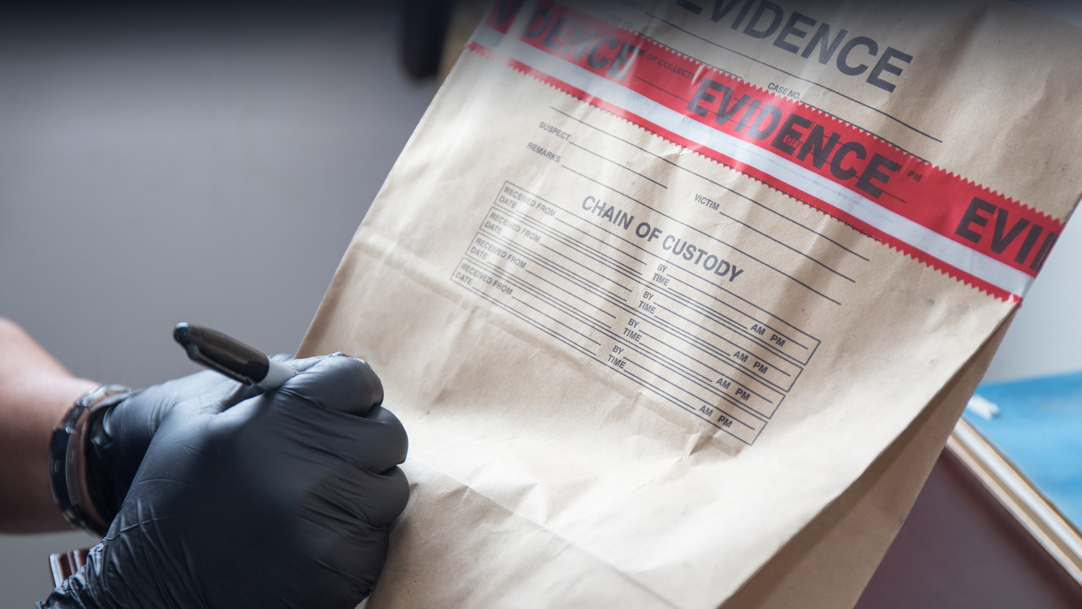
Creating Forensic Backups
Custom tags can also be created and added to the Tag database.
Notes:
shutterstock_431385100

Slide 20
In the following guided tour, we’ll tag and bookmark the SMS database, which contains sent and received iPhone messages.
20

Slide 21
Activity: Tagging Evidence
In this activity, you will tag the major databases and files in the iPhone image file.
50 Minutes

Slide 23
Extracting Data for Offline Analysis

Slide 24
Offline reviewing refers to the process of reviewing files outside of the main program, in this case, Autopsy.
24

Slide 25
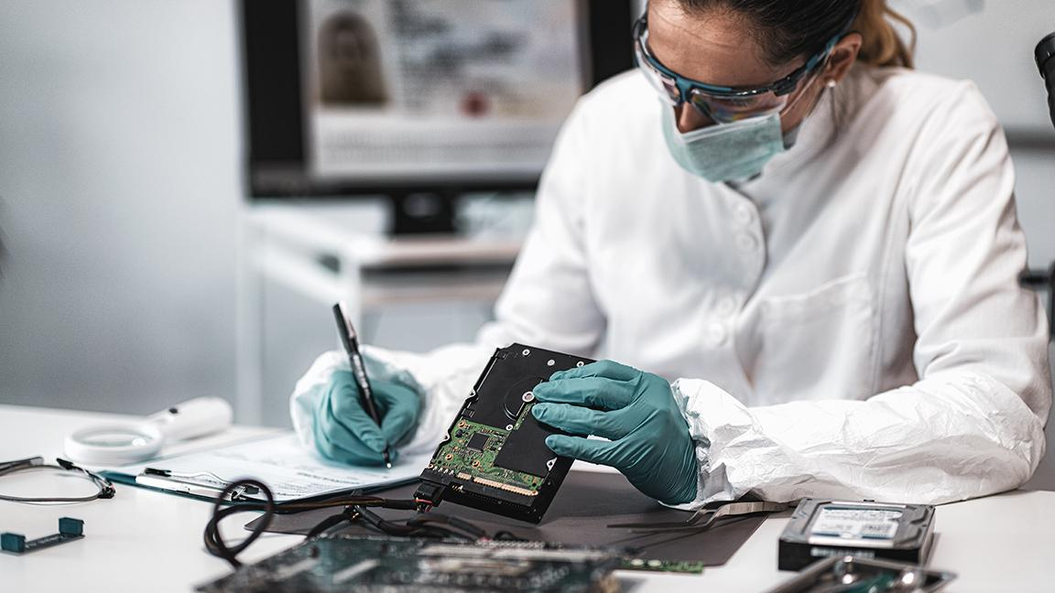

Sometimes investigators use other applications for further offline analysis. This is because:
Not all data types can be rendered in Autopsy.
Other tools can analyze video, photo, and audio files in more depth. E.g., photos may need to be enlarged, audio may need voice recognition, and video may need to be enhanced for facial recognition.
Database information can easily be transferred to spreadsheets or word documents where it can be manipulated into reports.
Notes:
shutterstock_1508063498

Slide 26
In the following guided tour, we’ll extract files and directories for offline reviewing.
26
Notes:
Shutterstock_535531051

Slide 27
Offline File Extraction

Slide 28
Activity: Extracting Data for Offline Analysis
In this activity, you will export files for offline examination.
20 Minutes

Slide 30

Wrap-Up
As a forensic investigator, you will work with a team as part of a large collaborative effort.
It's critical to understand how to use tools such as Autopsy and how to export data, allowing other team members to perform offline analysis of evidence.
30
Notes:
shutterstock_1711770013

Slide 31
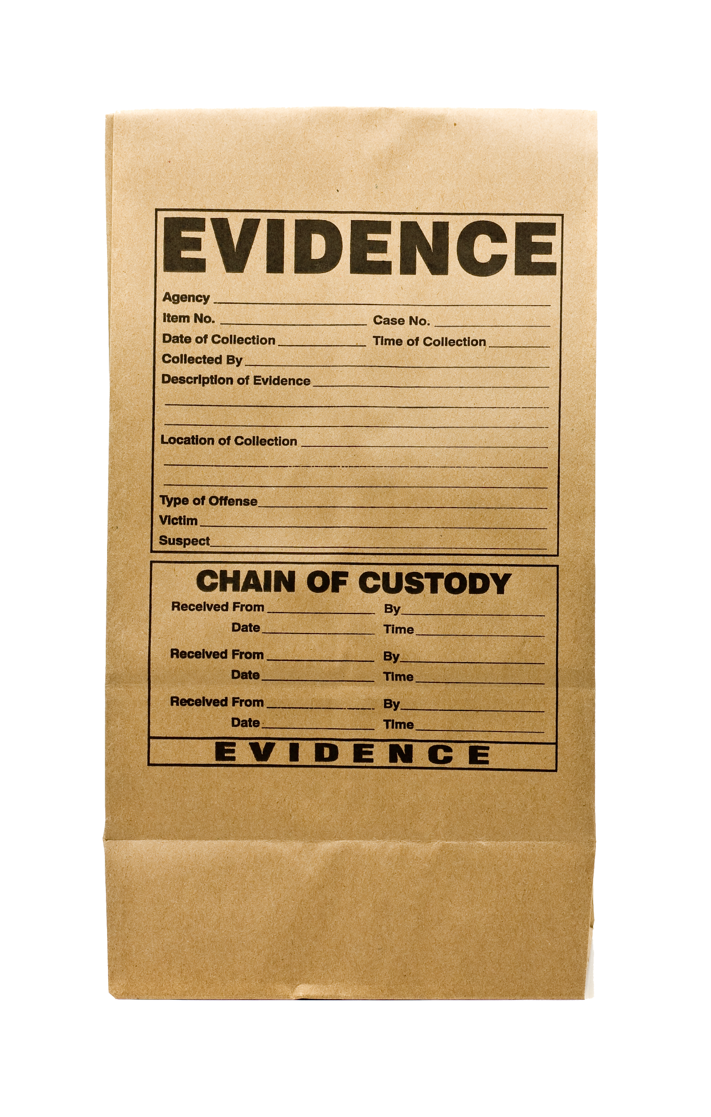
Wrap-Up
Tagging helps categorize and label evidence that has already been screened.
This eliminates double work and helps other investigative team members continue your work if you become unavailable.
31
Notes:
shutterstock_58889318

Slide 32
Next class, we will continue our investigation by analyzing email messages, SMS messages, and web history in order to tie Tracy to the case.
32

Slide 33
Questions?

